Slide 1
Harris Real Time & embedded Web server
Team Cobra Ouroboros
Notes:
andy

Slide 2
Agenda
Problem Description
Project Scope
Process
Requirements
Design
Testing & Quality Metrics
Implementation
Moving Forward
Demo / Q&A
Notes:
andy

Slide 3
Let Us Pretend…
Harris has two employees with project ideas:
Al - Quad Channel Man Pack
Betty - Falcon 3² Radio
Notes:
andy

Slide 4
Let Us Pretend…
Quad Channel Man Pack:
Radio 1
Int: Frequency
Radio 2
Int: Frequency
Radio 3
Int: Frequency
Radio 4
Int: Frequency
Falcon 3² Radio:
Radio 1
Int: Frequency
Falcon
Float:Velocity
Bool: Alive
Notes:
andy

Slide 5
Problem Description
Common Prototyping Platform
Lightweight Web Server
Highly Customizable
Interface with External Systems
Notes:
andy

Slide 6
Project Scope
Prototype
Full Stack
Everything from XML Input to HTML
Sample 3rd Party Applications
Notes:
andy

Slide 7
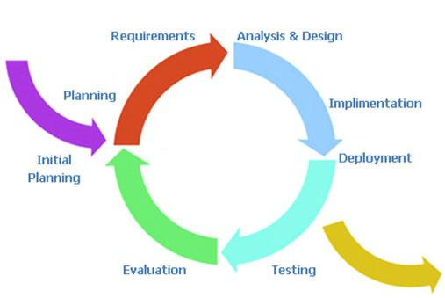
Process - Iterative
Prototyping Project
Stable Requirements
Need Implementation / Design Feedback
Communication with sponsor every two weeks
Notes:
-In terms of the process, we settled on doing an iterative approach, where we would go through the complete phases of development for what we estimated to be two major iterations, one per term.
-Very early on, after collecting requirements, sponsor made it clear that we should not expect changes to the requirements. This would negate some of the flexibility offered by other more agile methodologies such as Scrum. We also wanted to spend more time up front on design and learning what could and could not be done before delving in too deeply into the project. Most of this semester has been taken up with experimenting with technologies to that end.
-One advantage of this process is that it allows for us to deliver something by the end of this semester (which we are actively working on finishing), and thus get feedback. This isn’t the only time we have gotten feedback-- we are in communication with our sponsor about once every other week to make sure that we are understanding requirements correctly, that our design choices are in line with what the sponsor has in mind, and to show how the implementation is coming along.
Spent the beginning of the semester doing solely documentation and requirements gathering. Made Vision and Scope, SRS, and begun Use Cases and Risk Analysis documents. Moved on to design, and prototypes quickly followed. Prototypes revealed weaknesses and problems with design, and those were addressed. Basic testing is implemented. Now, at the end of this semester, we are planning on meeting up after fininshing our first deliverable, and then evaluating what went well, what could be improved, what’s the actual status of the implementation and project as a whole.

Slide 8
Requirements
Highly Configurable Server
Auto Generated HTML / Web Server Code
REST / C++ API
Callback Mechanism for 3rd Party Applications
Easily Expandable

Slide 9
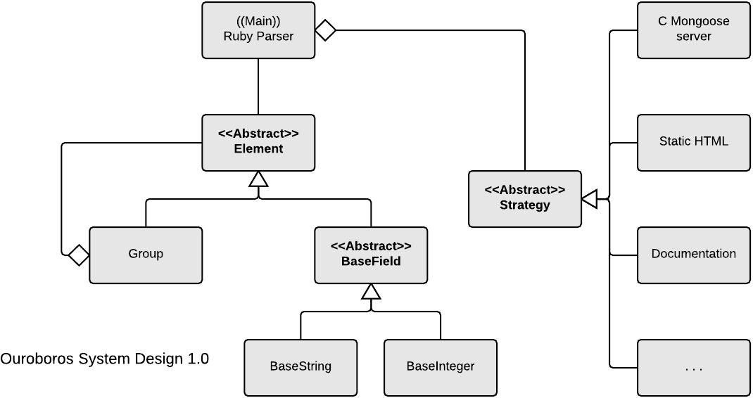
Design
Notes:
Todo - Placeholder Diagrams. Redo to match presentation theme and current content

Slide 10
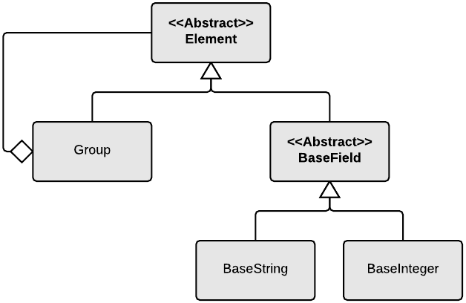
Design
Notes:
Todo - Placeholder Diagrams. Redo to match presentation theme and current content

Slide 11
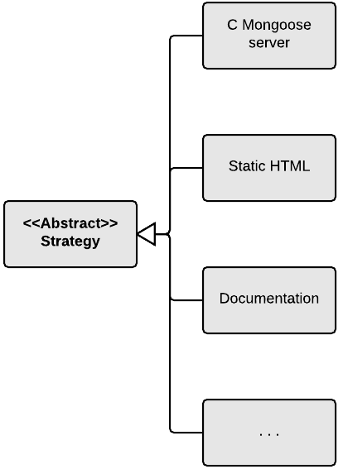
Design
Notes:
Todo - Placeholder Diagrams. Redo to match presentation theme and current content

Slide 12
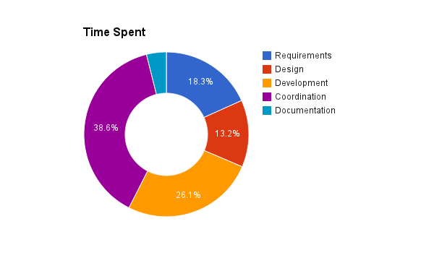
Testing & Quality Metrics
Average Estimation Error
Accountability Metric
Backend Unit Tests
Notes:
Gabe

Slide 13








Implementation
Notes:
Jared
TODO - Make this pretty later

Slide 14
Implementation
C vs C++ Web Server
Ruby RGEN Gem
Javascript Framework : Yes vs No
Use of XML Schema
Notes:
Jared
This slide discusses design choices we have made thus far as a group and why

Slide 15
Implementation
Working Prototype
Base Functionality Achieved
Current state of project
Notes:
Jared
This slide discusses current state of implementation.

Slide 16
Moving Forward
Plans for next semester
  Data types/enums
Generate documentation
Sockets for real time updating
CSS styling for HTML
Notes:
Gabe

Slide 17
Moving Forward
Good
Adaptive mindset
Specialized and collaborative
Bad
Too much time designing
Development workflow issues at start
Notes:
Gabe

Slide 18
Demo / Q&A
Text us!
415-237-6131
0 – Red 1 – Green
2 – Blue 3 – Yellow
4 – Cyan 5 – Magenta
6 - White

